Slide 1
LISTENING GENERAL ENGLISH 3
SAMPLE TESTS

Slide 2
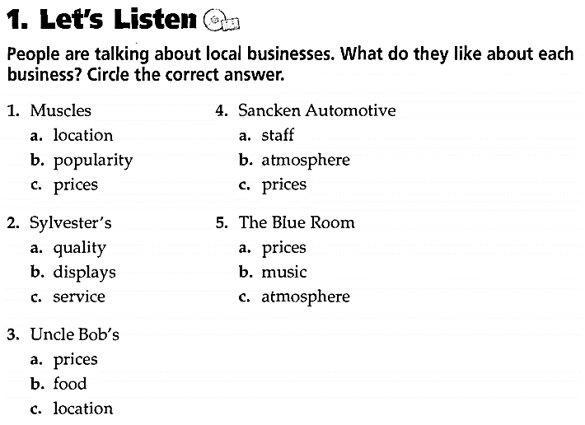

1

Slide 3
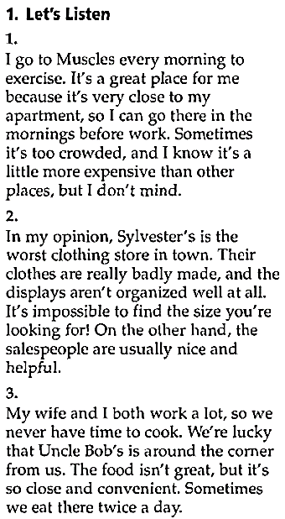
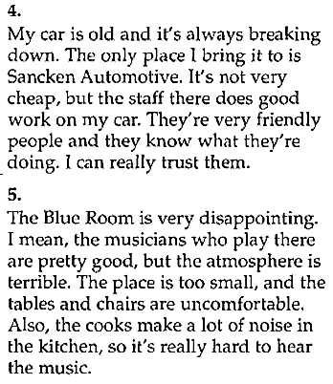

Slide 4
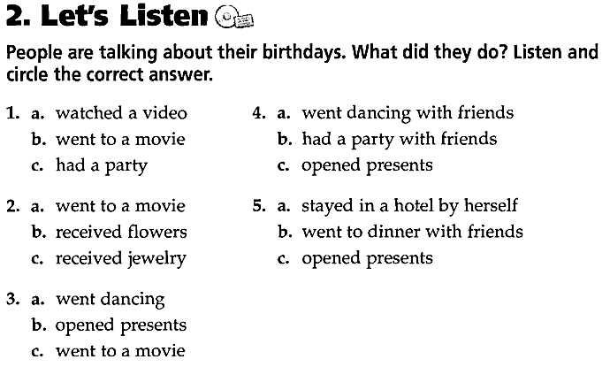
2

Slide 5
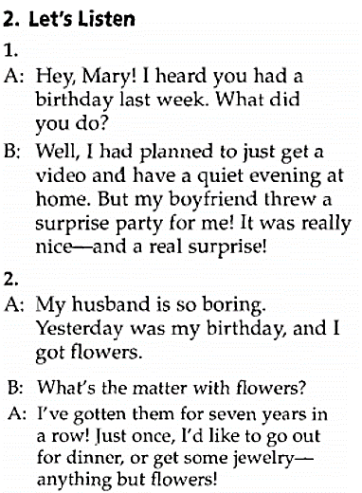
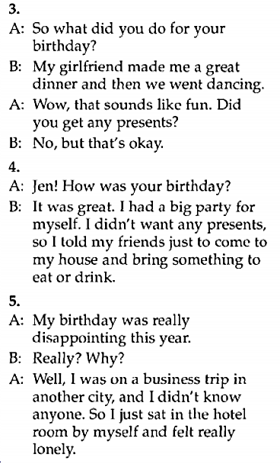

Slide 6
TAXIS4U
3
NAME OF PASSENGER: | SAM WILLIAMS
PICK UP DATE AND TIME: | (1) Wed 6th July…………………………….
PICK-UP POINT: NO. & STREET: TOWN: POSTCODE: | (2) …………………………WILLOWSIDE BANK (3) ……………………………………… (4) ………………………………………
MOBILE NUMBER: | (5) 07789……………………….
DESTINATION: | HEATHROW - TERMINAL 5
3:30
60
ABINGDON
OX143HB
612744

Slide 7
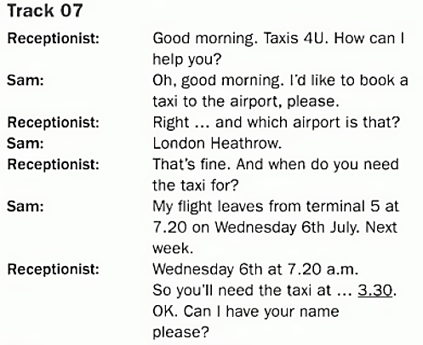
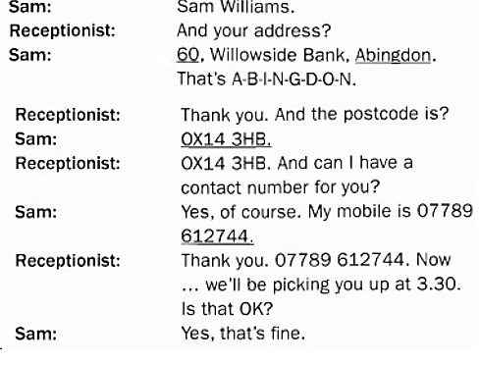

Slide 8
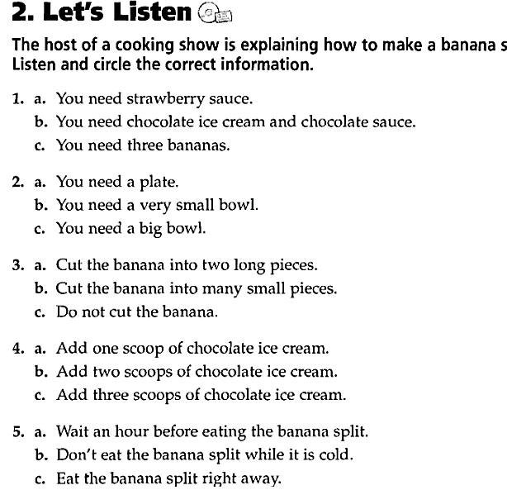
4

Slide 9
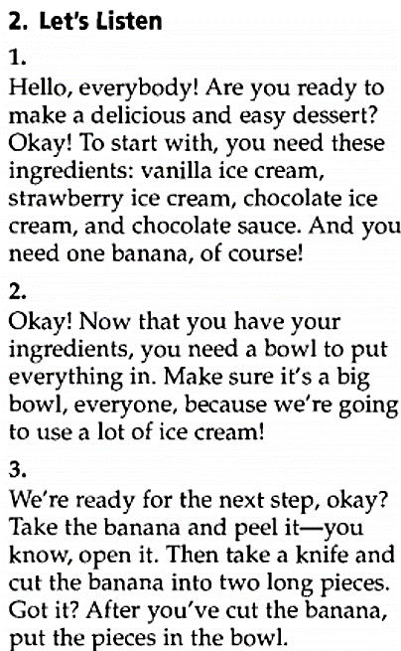
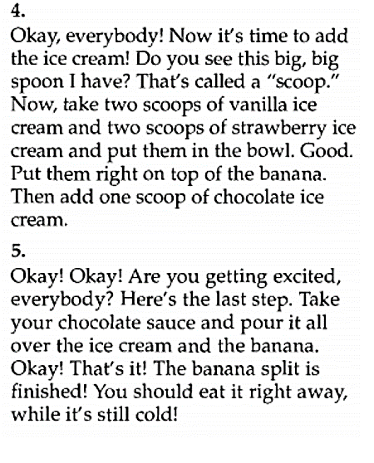

Slide 10
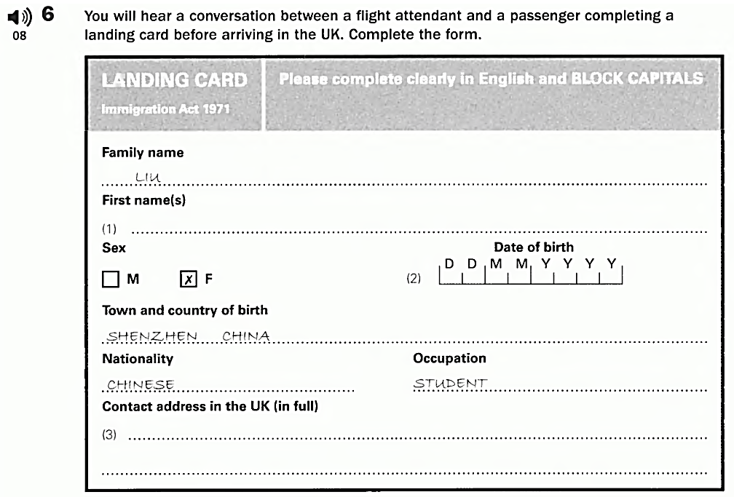
5
(1)
HUA
(2)
Fang
HUA
1994
(3)
17/12/----------------------
13
No & street:
Post code:
(4)
Park Road, Brighton
(5)
BN40 4GR

Slide 11
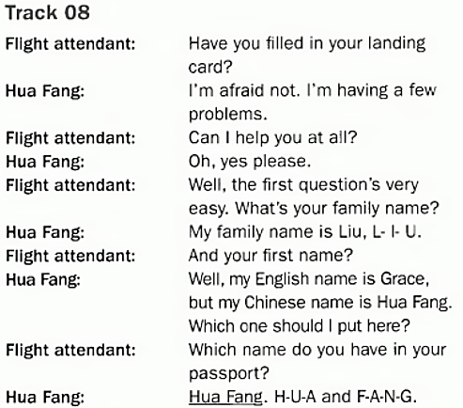
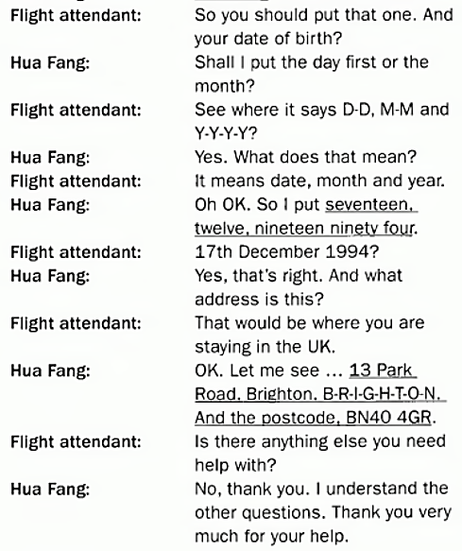

Slide 12
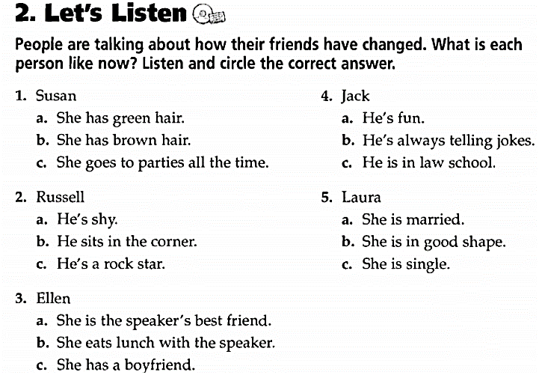
6

Slide 13
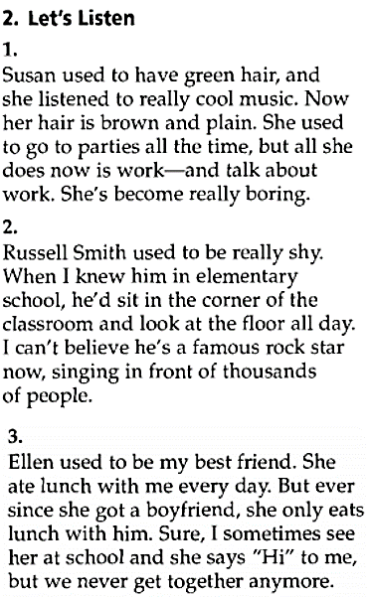
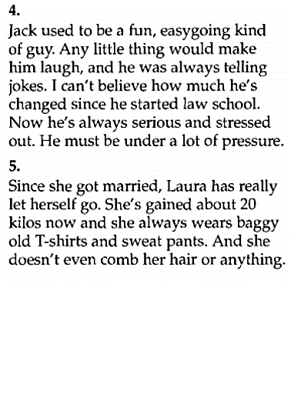

Slide 14
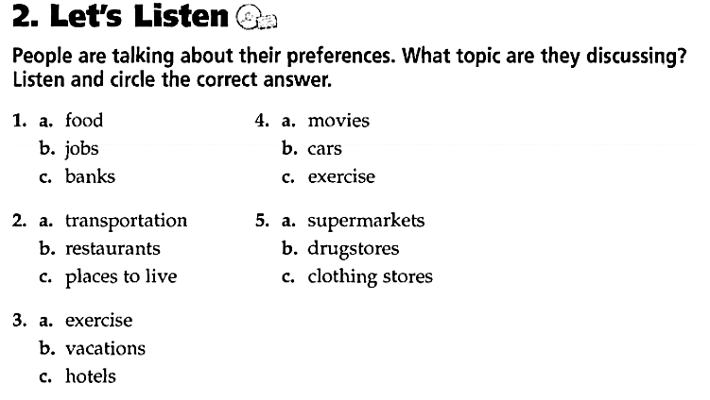
7

Slide 15
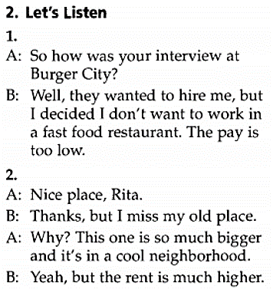
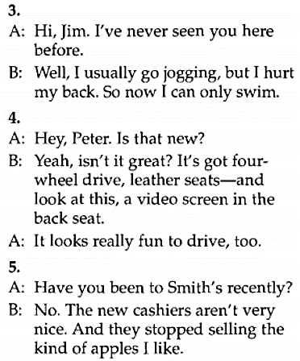

Slide 16
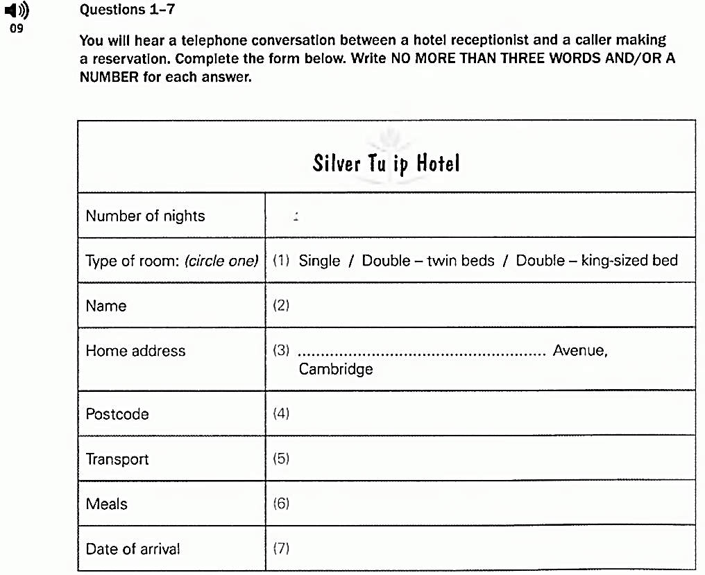
8
One
Edward
FRANCIS
23
CYPRESS
CB39NF
Taxi
Breakfast
Friday, 16 April

Slide 17
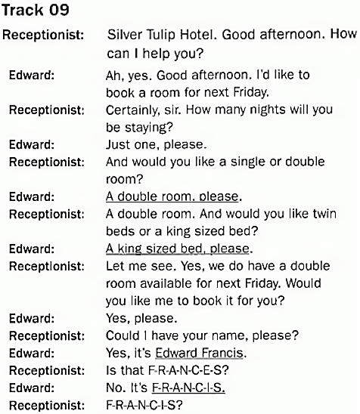
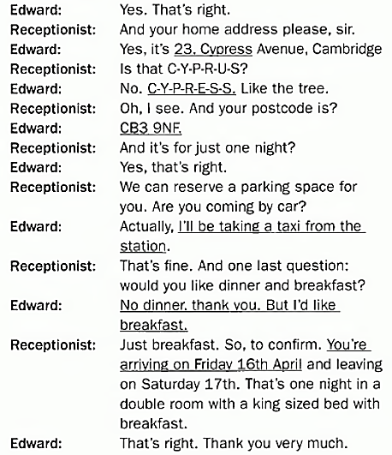

Slide 18

9
You will hear a conversation. Three students are asking to their tutor about the presentation they are planning. You will hear the conversation twice. Listen and circle the best answer A, B, or C.
What is the topic of the presentation?
A. How mobile phone are designed?
B. The risks caused by mobile phone?
C. How mobile phones are used?
2. How many sections do they have in the presentation?
A. 1 B. 2 C. 3
3. What does the introduction explain?
A. Dangers of mobile phones?
B. Importance of mobile phones
C. Importance of understanding the dangers of mobile phones
4. What are the students planning to do on the second slide?
A. Explain why mobile phones are dangerous
B. Point out some different kinds of risks
c. Mention ways to avoid the risks
5. What does the tutor suggest?
A. Not discussing the dangers of mobile phones
B. Discussing the benefits of mobile phones
C. Having an argument

Slide 19
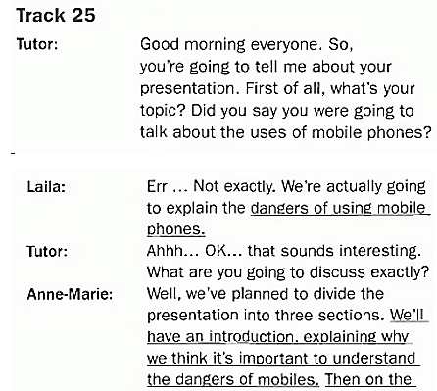
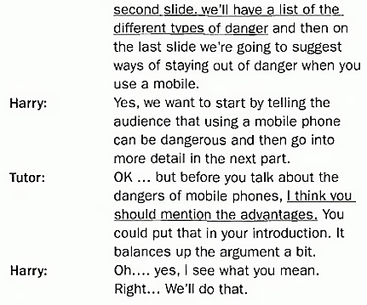

Slide 20
10
You will hear some describing how to cook a traditional dessert. You will hear the conversation twice. Listen and complete the missing information
A Traditional Dessert
What to Peel and cut into Slices | (1) -----------------------
How Long to Cook | (2) for about --------minutes
What Rub flour and Butter with | (3) your ---------------------------
What to add | (4) ---------------------------
How Long to Bake in the Oven | (5) for -------------------------- minutes
apples
10
fingers
sugar
30

Slide 21
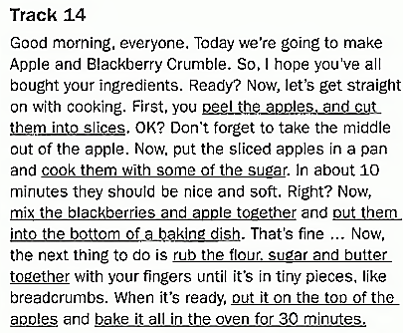

Slide 22
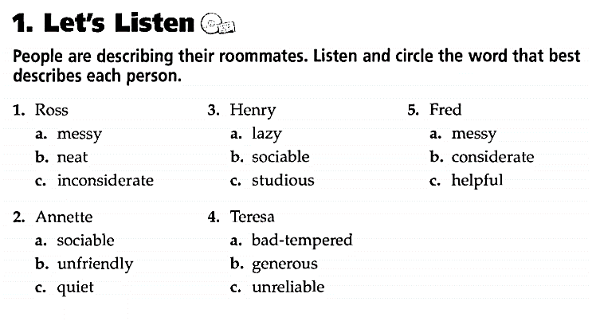
11

Slide 23
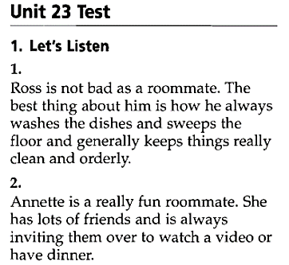
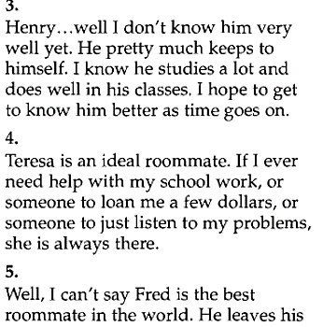
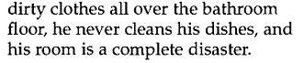

Slide 24
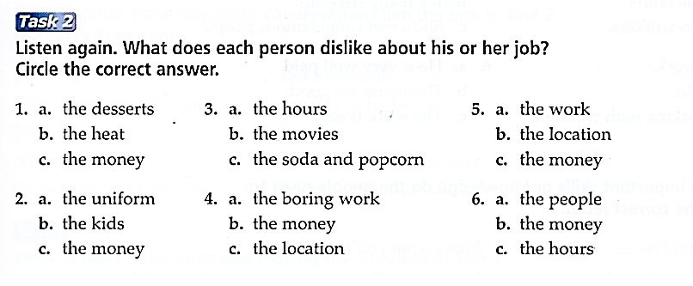
12

Slide 25
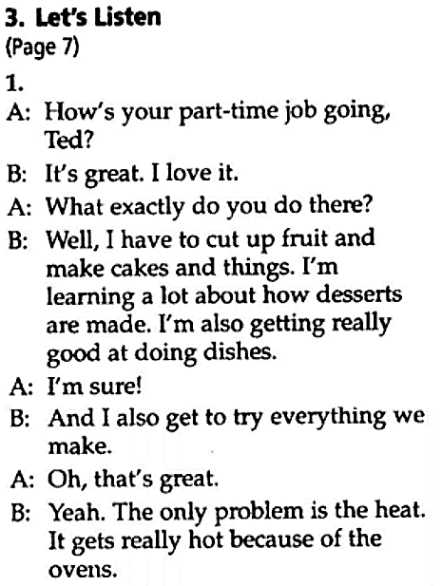
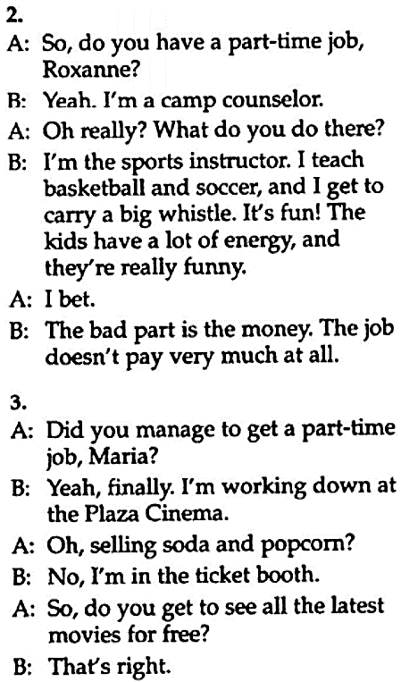

Slide 26
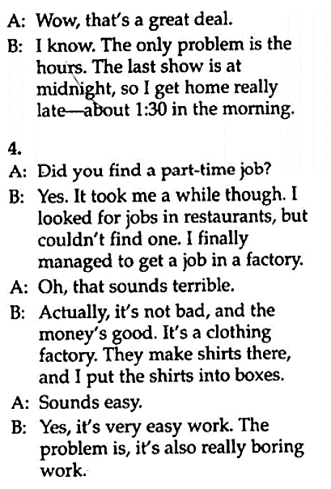
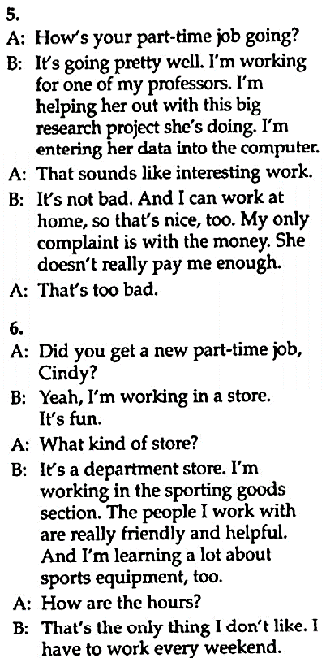

Slide 27
13
You will hear a student representative welcoming new students to a university and explaining a little about traditional English meals. You will hear the talk twice. Listen and complete the missing information.
Traditional English Meal
Fish and Chips | Fried in: (1) deep --------------------------
 | Not at all (2) ---------------------------
 | popular specially (3) on a -------------------------------- night
Sunday Lunch | roast meat with (4) -------------------------------
 | Traditional eaten at (5) -------------------------------
fat
healthy
Friday
vegetables
home

Slide 28
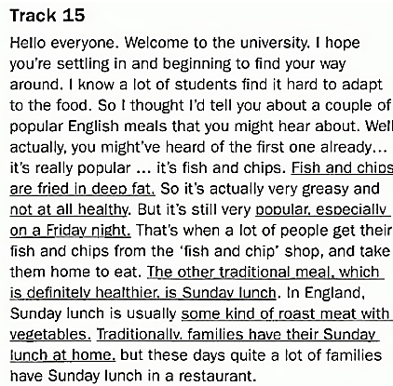

Slide 29
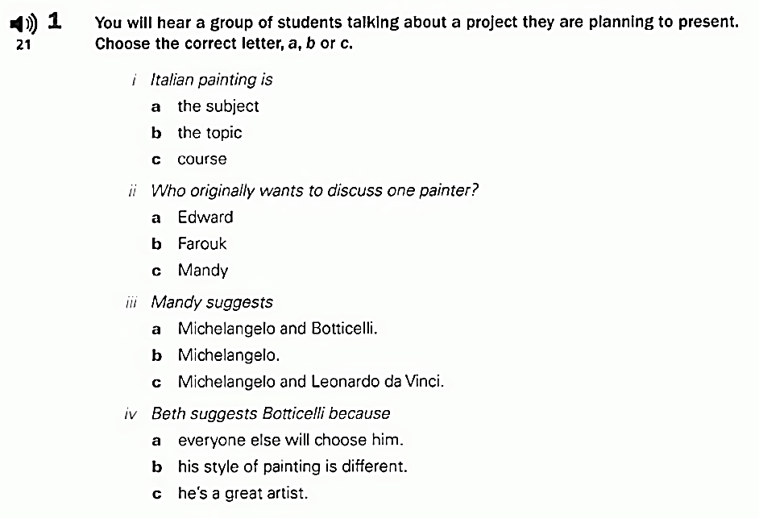
14
VI. How many artists are they going to present?
A. One 2. Two 3. Three

Slide 30
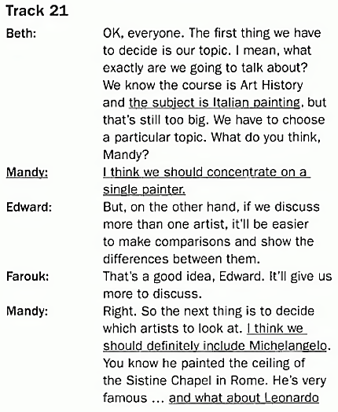
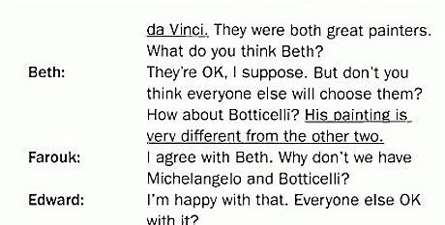

Slide 31
15
You will hear a woman talking to some students about her job. You will hear the talk twice. Listen and complete the missing information.
SUMMARY
Job: (1) ----------------------------- officer
Years: (2) -----------------------------
Studied (3) ----------------------------- at university
Interested in (4) ----------------------------- side, not theory
Accepted for (5) ----------------------------- after graduating
police
5
law
practical
training

Slide 32
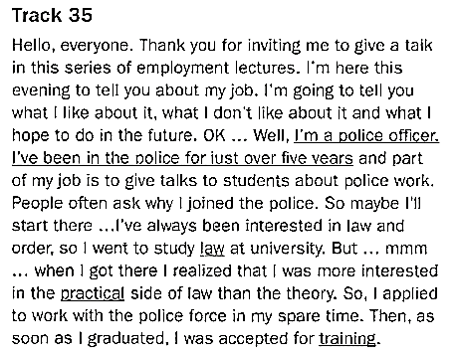

Slide 33
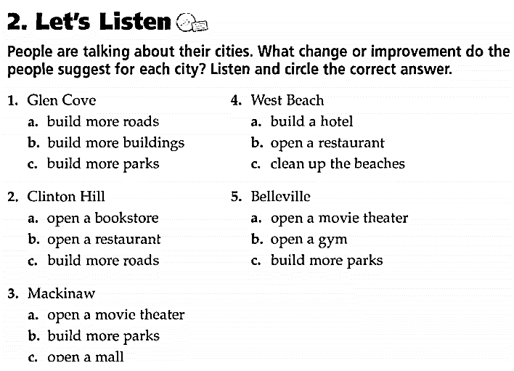
16

Slide 34
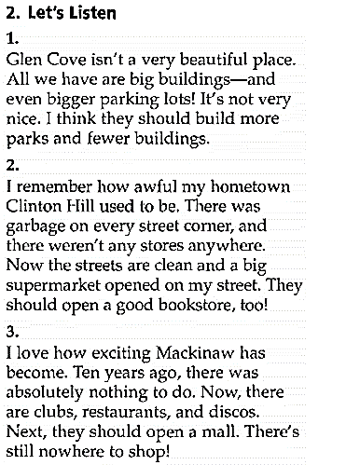
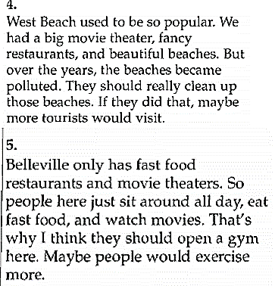

Slide 35
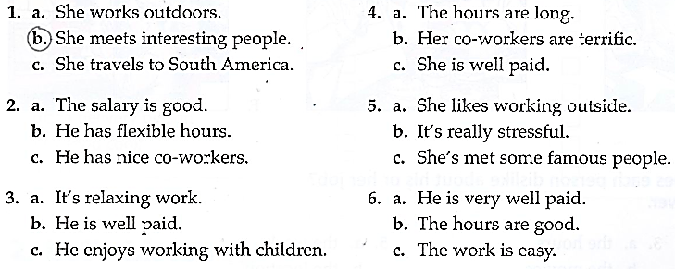
17
You will hear five short conversations. You will hear each conversation twice. There is a question for each conversation. Listen and circle the best answer A, B, or C.
b.

Slide 36
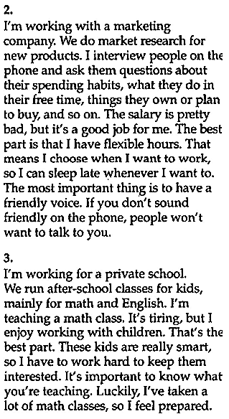
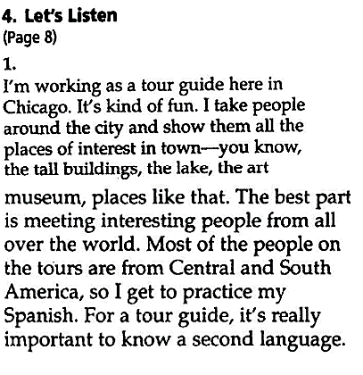
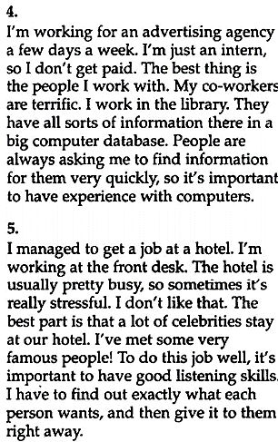

Slide 37
18
You will hear a talk about TV and radio. You will hear the talk twice. Listen and complete the missing information.
TV and radio in Britain There are two main broadcasting companies in Britain. One is BBC, the other is (1) ………………………
Radio 1 | (2) ……………………… music station with news, and magazine – style programs
Radio 2 | (3) ……………………… music and reports on sport
Radio 3 | (4) ……………………… music
Radio 4 | (5) ……………………… programs, drama, general interest programs
IBA – Independent Broadcasting Authority)
POP
Light
Classical
News

Slide 38
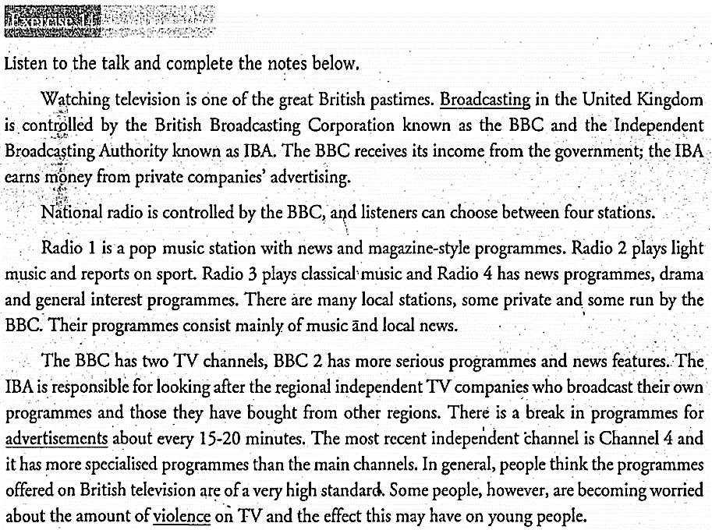

Slide 39
19
You will hear a talk about staying safe on campus. You will hear the talk twice. Listen and circle the best answer A, B, or C.
What is the talk mainly about?
a. campus b. crimes c. security
When can students ask a security officer to walk home with them?
a. in the evening b. after dark c. late at night
What does the security officer say students should do if they want to go home late at night and they feel nervous?
a. They should ring the campus security.
b. They should study in the library.
c. They should go home alone.
What does the security officer say about national and on campus emergency numbers?
a. They are both 999 b. They are both 333 c. They are not the same
Why should students call 3333 in the emergency on campus?
a. 999 does not work b. It is confusing c. It is faster

Slide 40
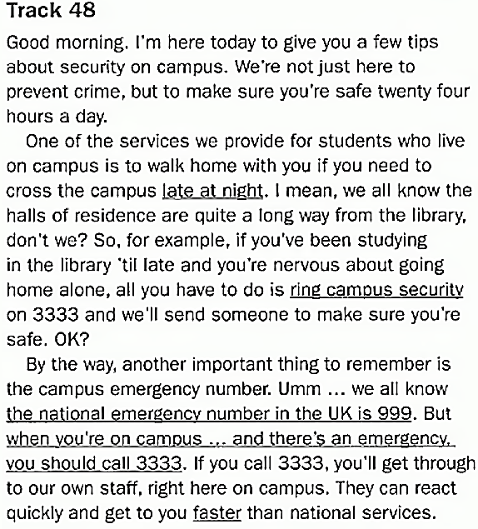

Slide 41
20
You will hear a talk about nutrition. You will hear the talk twice. Listen and complete the missing information.
SUMMARY
Topic: Healty Eating Definition Reason why people don’t (1) ……………………….. properly Ideas for (2) ……………………….. the situation Healthy Eating is: (3) Balanced ……………………….. Eating the right amount of (4) ……………………….. Note: a balanced diet includes meat, vegetables, (5) ……………………….., cereals and diary food.
eat
improve
diet
food
fruit

Slide 42
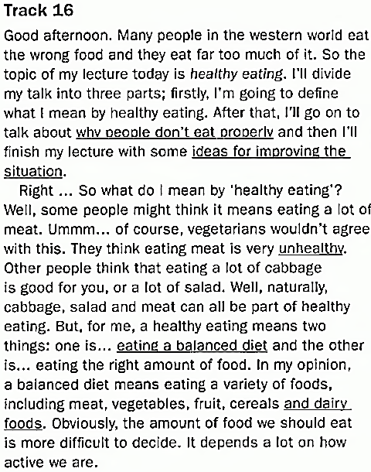

Slide 43

21

Slide 44



Slide 45

22

Slide 46




Slide 47
23
You will hear a woman describe her job. You will hear the talk twice. Listen and complete the missing information.
Alice’s Job
She works on farm. - Grow (1) ………………………… - keeps chicken, ducks and diary (2) ………………………… - Worst part of job: going out in winter to feed (3) ………………………… - Likes working outdoors in the summer - Trucks deliver to (4) ………………………… - Supplies local shops with milk, eggs, cheese - Sells directly to (5) the ………………………… in farm shop
fruit
cows
animals
supermarkets
public

Slide 48


Slide 49
24
You will hear a talk about tourism. You will hear the talk twice. Listen and circle the answer A, B, or C
What are tourists advised not to wear in the street?
A. expensive jewelry B. cameras C. expensive clothes
2. Where should tourists not to go after dark?
A. cash machines B. dark places C. lonely places
3. What did the travel advisor think about India?
A. It was dangerous B. It was organized C. It was safe
4. Why does the speaker recommend going to India with a tour group?
A. Because it’s more fun B. because it’s less risky
C. because they don’t need cash
5. What did the tour guide tell the tourists not to do?
A. speak their own language B. go with the people they don’t know
C. Be nice and friendly

Slide 50



Slide 51
25
You will hear a conversation about climbing club. You will hear the conversation twice. Listen and complete the missing information.
Mountain High Climbing Club
Name | (1) Andrew ………………………
Age | (2) ………………………
Address | (3) ……………………… Highbury Square
Area | (4) ………………………, W1
Telephone No | (5) 07209………………………
Health problem | No
Previous experience | None, Some, Extensive
Metcalfe
21
43A
London
571324

Slide 52



